Slide 1
Digital Portfolio
STUDENT NAME: YASWANTH.R
REGISTER NO AND NMID: 222404575/ASUNM130124J010
DEPARTMENT: B.SC.SOFTWARE APPLICATION
COLLEGE:AGURCHAND MANMUL JAIN COLLEGE/ UNIVERSITY

Slide 2
PROJECT TITLE DIGITAL PROTFOLIO

Slide 3


AGENDA
Problem Statement
Project Overview
End Users
Tools and Technologies
Portfolio design and Layout
Features and Functionality
Results and Screenshots
Conclusion
Github Link
3/21/2024 Annual Review

Slide 4

PROBLEM STATEMENT 1)Building the structure 2)giving prefect colours 3)inserting pictures 4)making scrolling smooth 5)making it responsive

Slide 5

PROJECT OVERVIEW A Digital Portfolio fully attached about my skills in the software world and also it holds my project i have linked my github , linkedin ,Twitter profile

Slide 6

WHO ARE THE END USERS?
The Companies I go for Interview My Online Clients

Slide 7

TOOLS AND TECHNIQUES
HTML
css
JAVASCRI PT

Slide 8
POTFOLIO DESIGN AND LAYOUT
It has a maginificent Purple blended violet colors and it has my profile photo , My name in the Starting
after scrolling down you can find my projects , and what Skills do i have and lastly you got a information box
to fill up your details and get in touch with me...
- Thank you!!
8

Slide 9
FEATURES AND FUNCTIONALITY
Displays My Essential Details
Scrolls Smootly
it has a Arrow button in the left to scroll up from down

Slide 10
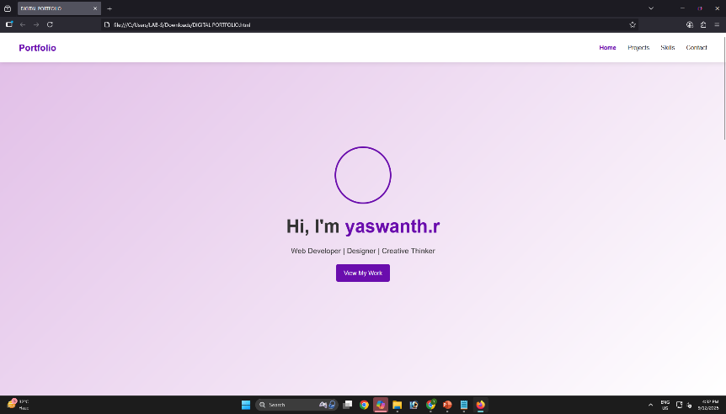
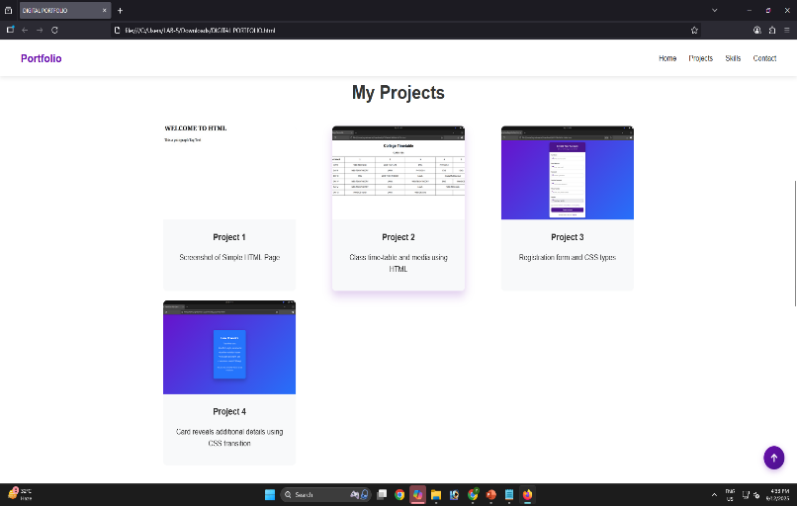

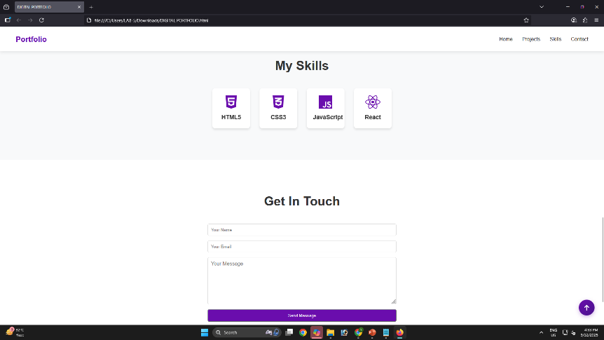
RESULTS AND SCREENSHOTS
3/21/2024 Annual Review
10

Slide 11
CONCLUSION
I have created this Portfolio with my Hardwork and
Consistency
Github link: https://github.com/yaswanth992/portfolio.git
Protfolio link: https://yaswanth992.github.io/portfolio/
11

